Slide 1
Computational Guided Inquiry: Estimating the Total Economic Value of Ecosystem Services in the Arctic
This module was created by Lea Fortmann, Department of Economics at the University of Puget Sound. Contact the author at lfortmann@pugetsound.edu. Funding for this project comes from NSF award #1712282 by the Division of Undergraduate Education and Office of Polar Programs

Slide 2
Module Overview and Learning Objectives
In this module you will apply a variety of methods to estimate the annual value of the Arctic by conducting a partial replication of the peer reviewed article, “Economic value of ecosystem services, minerals and oil in a melting Arctic: A preliminary assessment” published in the journal Ecosystem Services (O’Garra 2017). To conduct this analysis, you will gather data from primary sources, convert it into annual values, and adjust for exchange rates and inflation using the same sources and assumptions made by O’Garra in her original paper.
Module Outline
Introduction
Part 1: Gathering the Data
Part 2: Converting the Data in Microsoft Excel
Part 3: Calculating the Total Economic Value of the Arctic
Discussion Questions
Learning Objectives:
Increase climate literacy by engaging in academic research based on the value of lost ecosystem services in the Arctic associated with climate change.
Apply the total economic valuation framework to estimating the annual value of the Arctic and identify the key assumptions made in the estimation and how they impact the final value.
Employ economic and computational skills through working in Microsoft Excel including, adjusting for inflation, converting currency, and tabulating and organizing data.

Slide 3
Introduction – Climate Connection
Among the many impacts of climate change, some of the most extreme effects are expected to happen in the polar regions (the Arctic and Antarctic) due to polar amplifications. The Arctic encompasses the northern most region of the globe and includes portions of eight countries: the United States (Alaska), Canada, Russia, Greenland, Norway, Sweden, Iceland, and Finland.
The Arctic provides numerous benefits to both local populations and the global community. It is home to dozens of species, including polar bears, reindeer, and whales, and provides a number of ecosystem services through climate regulation, biodiversity, and much more. However, given that these resources are not typically exchanged in a market and do not have a price tag associated with them, trying to get estimates for the value of these non-market goods can be a challenge.
Image Source: File:Arctic.svg, CIA World Fact Book

Slide 4
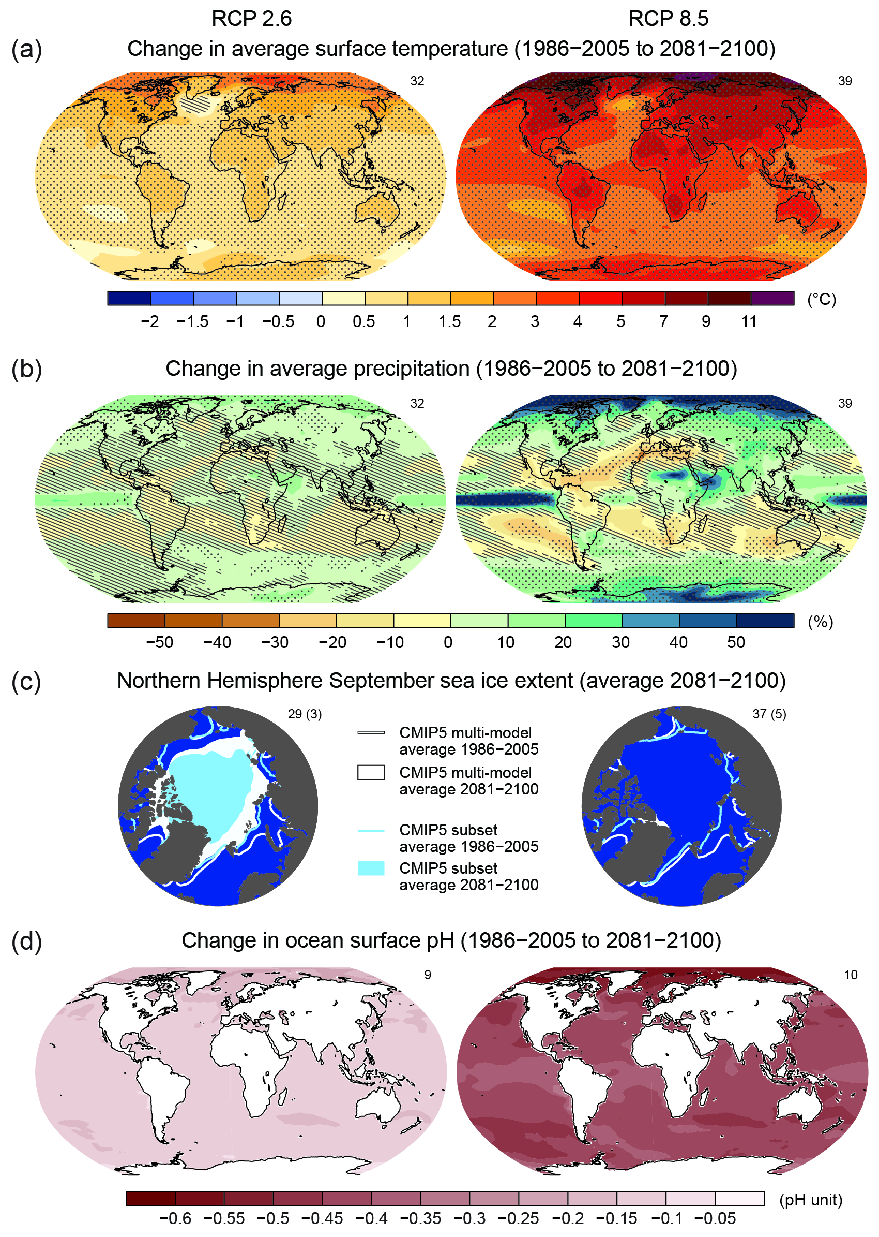
Introduction – Amplified Warming in the Polar Regions
The maps to the right show the predicted changes in average temperature (a) and precipitation (b) from the years 1986-2005 to 2081-2100 for two GHG emissions scenarios, RCP.2.6 which predicts moderate warming, and RCP 8.5 which would result under continued high levels of emissions.
Under a scenario of moderate future GHG emissions, changes in temperature for the United States are predicted to be about 1.5°C (or 2.7 °F) by 2100. However, in the Arctic, temperature increases could be as large as 11°C (or 19.8 °F).
The potential cost of damages under extreme temperatures and melting Arctic ice could result in irreparable changes to the region and loss of essential functions important for global climate regulation. Thus, estimating the value of the Arctic’s resources, ecosystem services, and existence are important factors to be included in economic analyses when determining how to best allocate scarce resources to mitigate the impacts of climate change.
Source: Figure SPM 7 from IPCC, 2013: Climate Change 2013: The Physical Science Basis. Contribution of Working Group I to the Fifth Assessment Report of the Intergovernmental Panel on Climate Change [Stocker, T.F., D. Qin, G.-K. Plattner, M. Tignor, S.K. Allen, J. Boschung, A. Nauels, Y. Xia, V. Bex and P.M. Midgley (eds.)]. Cambridge University Press, Cambridge, United Kingdom and New York, NY, USA, 1535 pp.

Slide 5
Introduction – The Total Economic Value Framework
The total value of a resource, such as the Arctic, includes both use and nonuse values and can be summarized in the figure below. The sum of all these values combined is the Total Economic Value (TEV) of a resource. In this module you will estimate the total economic value of the Arctic, based on both use and nonuse values using a variety of valuation techniques.
Use values include both direct use of a resource, such as fishing or hiking, and indirect use, such as water filtration benefits.
Nonuse values include values from knowing a resource is in existence (e.g. the Grand Canyon) and the bequest value of wanting to preserve a resource for future generations, such as your grandchildren.
Option value refers to the value one holds due to wanting to preserve the resource for future use (e.g. the Amazon Rain forest for future pharmaceutical discoveries).
Pause for Analysis: Consider the total economic value of the Arctic, what do you think are some of direct and indirect use values that should be included?

Slide 6
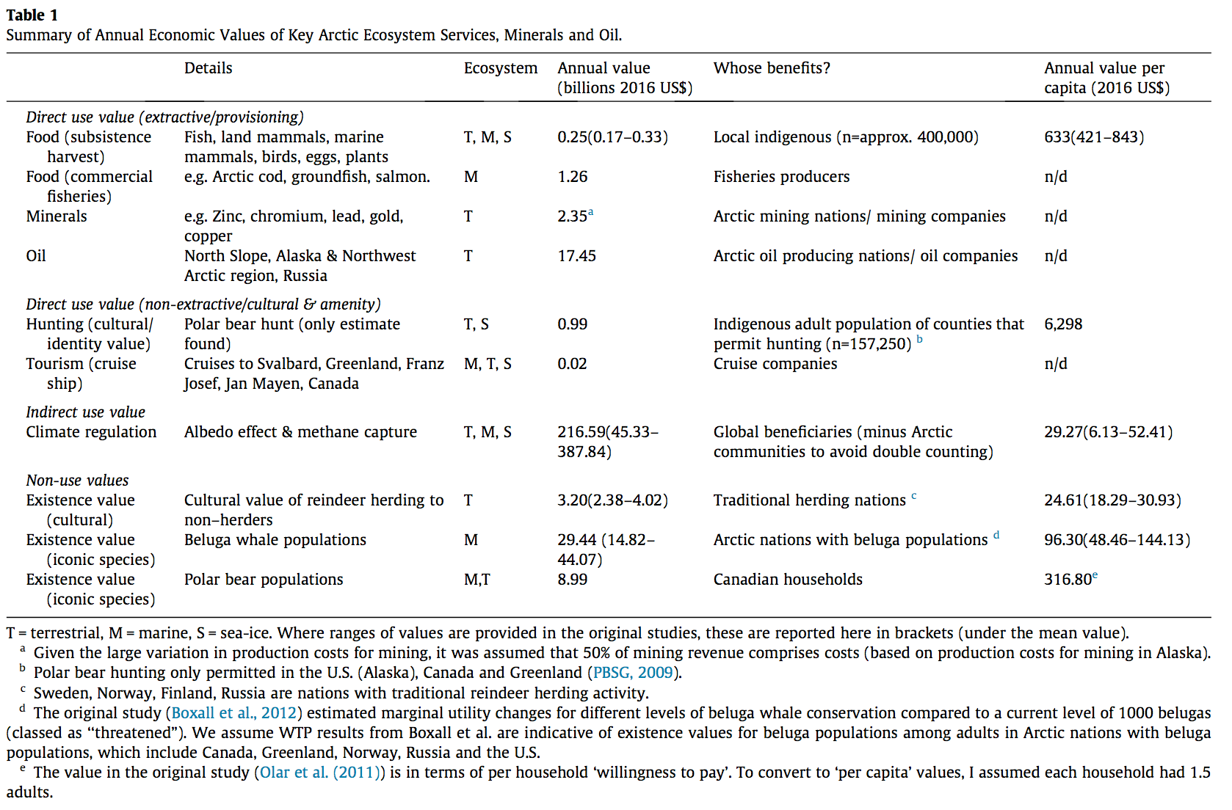
Introduction – Total Economic Valuation of the Arctic
The estimation of the TEV of the Arctic that you will be conducting in this module is based on a partial replication of a study by O’Garra (2017) from the journal Ecosystem Services. Table 1 below displays the main table from the paper that you will be replicating, but with some updates using more current data.
Table 1 includes direct use values, such as mining and fishing, as well as nonuse values such as the existence value of polar bears and cultural heritage values of reindeer. The estimation of these values rely on environmental valuation techniques such as contingent valuation, benefits transfer, and market valuation of the goods and services provided by the Arctic.
Pause for Analysis: In addition to the values listed in Table 1 from the O’Garra (2017) paper, what are some other values of the Arctic not included in this analysis?

Slide 7
Part I: Gathering the Data
In this section, you will begin the analysis by gathering data from a number of primary sources to use for the final calculation. You will refer to the same sources used by O’Garra (2017) to identify the information and record it in Excel. In the next section you will convert the data you gathered here to annual values.
To begin, open the “CGI TEV Arctic Spreadsheet” in Excel and click on the tab “Part 1. Data” at the bottom.
Here you will see Tables 1 and 2. All of the values in the last column in Table 1 are taken directly from the O’Garra (2017) paper. The colored rows are the missing values that you will fill in as part of the replication.
The colors in Table 1 correspond to the same colors in Table 2, which matches the sources you will refer to when collecting the data for each resource or service (e.g. subsistence food, climate regulation, etc.).
For each data source you will record the relevant values, units, and the year the data was collected in Table 2.

Slide 8
Part I: Gathering the Data
The references listed below are the same sources used in the O’Garra (2017) paper except for an updated report on subsistence hunting and fishing in Alaska (Fall 2016), you will refer to the more recent report using 2014 data instead of the 2012 data used in the O’Garra paper. You will be guided through selected sections of the papers and reports starting with the Fall (2016) report on the next slide.
Reference Papers:
Fall, J.A. (2016) Subsistence in Alaska: A Year 2014 Update. Division of Subsistence, Alaska Division of Fish and Game.
Goodstein, E., Euskirchen, E., & Huntington, H. (2010). An initial estimate of the cost of lost climate regulation services due to changes in the Arctic Cryosphere. Washington, DC: Pew Centre.
Olar, M. et al. (2011). Evidence of the socio-economic importance of polar bears for Canada. Prepared by ÉcoResources Consultants, for Environment Canada.
Boxall, P. C., Adamowicz, W. L., Olar, M., West, G. E., & Cantin, G. (2012). Analysis of the economic benefits associated with the recovery of threatened marine mammal species in the Canadian St. Lawrence Estuary. Marine Policy, 36(1), 189-197.

Slide 9
Part I: Gathering the Data – Subsistence Harvesting in Alaska
The Fall (2016) report outlines the current status of subsistence food harvesting in Alaska in 2014 by indigenous populations that hunt and fish to catch food for their personal consumption. The report provides the monetary value of subsistence harvests, including the replacement costs and the quantity of food harvested per person in both rural and urban areas. Using the information from the report, you will fill out the orange rows in Table 2. To start, follow the instructions in red below.
1. Skim over the report focusing on page 3 to find the per pound replacement value of subsistence harvests (dollar range) and the average per capita harvests for both rural and urban populations.
2. Based on the information in the report, fill in the orange rows in Table 2 in Excel, including the units (e.g. pounds, dollars per pound, Canadian dollars, etc.) and the year the data was recorded for the inflation adjustment later.
Pause for Analysis: When considering the monetary value of subsistence food harvesting, what does the “replacement value” represent?
Title: Five Eskimos fishing from the beach with nets
Source: University of Washington: Special Collections
Notes:
Fall report link: https://www.adfg.alaska.gov/static/home/subsistence/pdfs/subsistence_update_2014.pdf

Slide 10
Part I: Gathering the Data – Subsistence Harvesting in Alaska
The Fall (2016) report is only for Alaska. Since we do not have data on subsistence hunting and fishing for all of the Arctic, you will extrapolate the values from Alaska to the rest of the Arctic population. If you assume that indigenous populations are the primary ones doing the subsistence hunting and fishing, then only this subset of the total population of the Arctic should be included in the estimation.
1. To estimate the number of indigenous people living in the Arctic, go to this website managed by the Arctic Council.
2. Skim over the webpage to find:
the total population of the Arctic, and
the percentage of people in the Arctic that are indigenous.
3. Record the data in the green section of Table 2 in Excel.
4. Using the information you just collected, estimate the population of indigenous people in the Arctic (your own calculation) and record it in Table 2.
In Part 2 of the module, you will use these values to estimate the total value of subsistence harvesting in the Arctic.
Photo Credit: Jewelry made of reindeer antlers with reindeer etching | Original photo by Linnea Nordström
Notes:
Arctic Council Website: http://www.wwdw.arctic-council.org/index.php/en/our-work/arctic-peoples

Slide 11
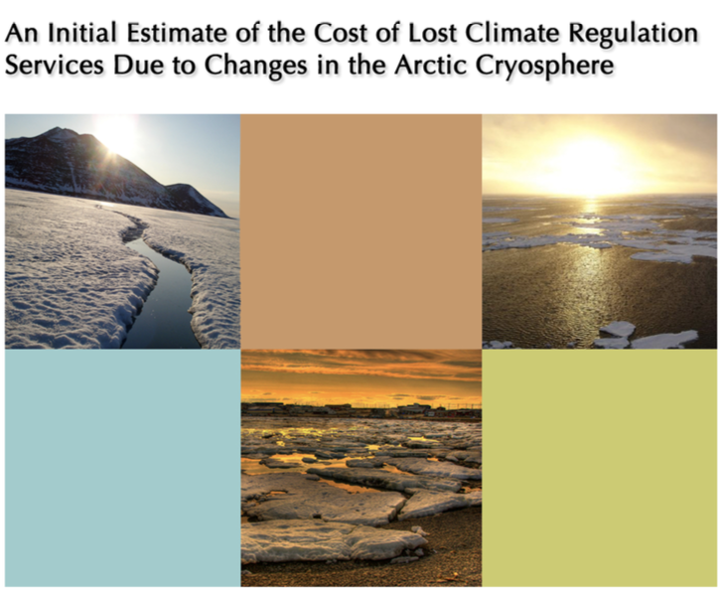
Part I: Gathering the Data – Climate Regulation
The Arctic provides a number of global benefits, the biggest being climate regulation. Goldstein et al. (2010) estimate the damage costs of warming in the Arctic due to lost climate regulation services. You will refer to this report to complete the red section in Table 2.
1. To gain a better understanding of the role the Arctic plays in regulating the climate, skim pages 1-3 of the Introduction of the Goldstein et al. (2010) paper and complete the pause for analysis question below.
2. Now fill out the red row in Table 2 for the estimated range of the value for lost climate regulation services in the Arctic in 2010 (be sure to include the unit and the year in the table).
Pause for Analysis: In a small group or with a partner, discuss how the snow and ice albedo feedback loop works and how it relates to changing temperatures.
Eban Goodstein, Bard Center for Environmental Policy, Bard College
Eugenie Euskirchen, Institute of Arctic Biology, University of Alaska Fairbanks,
Henry Huntington, Pew Environmental Group. February 2010

Slide 12
Part I: Gathering the Data – Socio-economic importance of polar bears
Polar bears have become an iconic symbol for climate change and encompass both cultural and economic values for Arctic populations. The paper by Olar et al. (2011) estimates both use and nonuse (aka passive use) values of polar bears in Canada. For the purposes of this analysis, you will focus on the nonuse value of polar bears, specifically, their existence value as a cultural symbol.
1. Read the Executive Summary of the Olar et al. (2010) paper and answer the pause for analysis question below.
2. Based on the information in the Executive Summary, fill out the blue section in Table 2 for the per household existence value of polar bears in Canada based on household willingness-to-pay to preserve the species.
Pause for Analysis: In a small group or with a partner, discuss what the purpose of this study is and why you think it matters.
Photo Credit: Alan Wilson http://www.naturespicsonline.com/copyright

Slide 13
Part I: Gathering the Data – Economic benefits of marine mammals
The final paper you will refer to is by Boxall et al. (2012) which estimates the existence value of beluga whales, another iconic species for the Arctic region, based on how much households are willing to pay to reduce their risk levels for extinction. You will use the information from this paper to complete the purple row of Table 2.
1. Read the Introduction and Part 2 of Boxall et al. (2012) to get a general overview of the paper.
2. To extract the relevant data from the paper refer to section “4.3 Willingness to pay estimates”, and skim to find the estimated range of values for household WTP for marine mammal recovery programs.
3. Fill out the final row in Table 2 with the relevant information.
Now that you have collected all the data, in the next section you will use the information you gathered to convert the data to annual values following the work of O’Garra (2017).
Source: premier.gov.ru
Pause for Analysis: Do you think that the approach the researchers use in this study to estimate the existence value of marine mammals is reasonable? Why or why not?

Slide 14
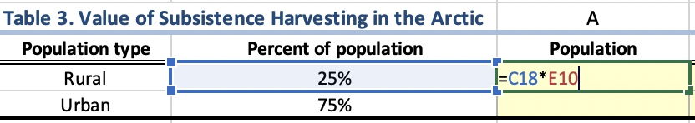
Part 2: Converting the Data in Excel to Annual Values
In this section, you will begin by estimating the value of subsistence hunting using the data you collected from the Fall (2016) report and the Arctic Council Website. You will also need to make some assumptions about what percentage of the rural and urban populations in the Arctic are indigenous. For this, you will use the same assumptions O’Garra used in her estimation, that 25% of the indigenous population lives in rural areas, and the other 75% lives in urban areas.
1. To start, go to the next tab in the Excel spreadsheet labeled “Part 2. TEV Calculations”. Notice that Table 2 from the previous tab is replicated at the top of the spreadsheet and the values you entered and automatically filled in.
2. Complete Column A in Table 3, calculating the population of indigenous people living in rural and urban areas. You can do this in Excel by entering the following formula “=C18*E10” then hitting ”Enter”. The cell C18 refers to the rural population percentage and E10 refers to the indigenous population data from Table 2.
3. Repeat Step 2 for the urban population, assuming that 75% of the Arctic indigenous population lives in urban areas.
4. Next, calculate the total pounds harvested by each population in Column B using the average per capita subsistence harvest data for rural and urban populations in Table 2 and the population data you just calculated in Column A.
Excel Tip: When entering a formula in Excel after you type the “=“ sign, you can reference a cell by typing in the name of the cell (e.g. C18) or you can click on the cell you want to reference and it will appear in the formula.
To get out of formula mode in Excel, hit the “ESC” key in the upper left corner of your keyboard.

Slide 15

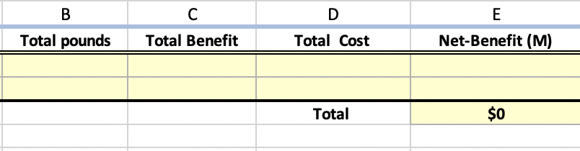
Part 2: Estimating the Value of Subsistence Hunting
Hunting game is a valuable resource provided by the Arctic environment, however it also requires time and resources. Thus, the estimated value of subsistence hunting should be based on the net benefit, which factors in the costs of hunting and fishing for subsistence food. Again, you will use the same assumption as O’Garra – that the cost of gathering food is 20% of the total value of the food (based on replacement costs).
1. Calculate the Total Benefit of subsistence hunting in Column C in Table 3 for rural and urban populations using the average replacement cost per pound (from Table 2) and the total number of pounds harvested from each population (column B).
2. Next, fill in column D by calculating the estimated Total Cost of harvesting based on the assumption that the cost of gathering food is 20% of the total value of the food based on replacement costs.
3. Calculate the Net Benefit in Column E (Total Benefit – Total Cost) for each population type.
4. To make the numbers more manageable, convert the Net-Benefit value in Column E to millions → “=(F18-G18)/1000000”
5. Finally, take the sum of column E to get the total economic value of subsistence harvesting in millions.
Pause for Analysis: O’Garra assumes that the cost of harvesting is 20% of the total value of the harvest. What do you think are some examples of the types of costs that are accounted for in this 20%?

Slide 16
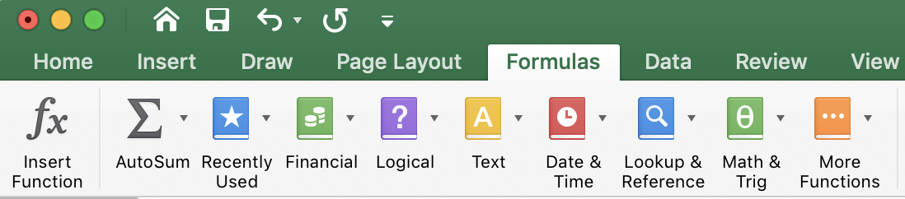
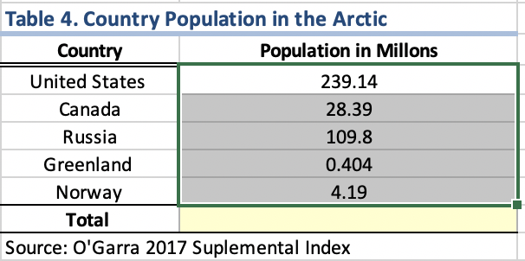
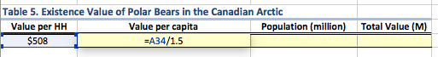
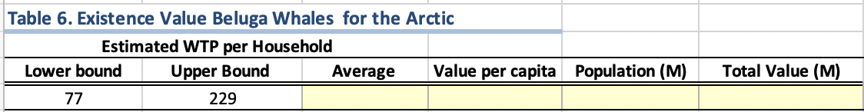
Part 2: Existence values for Polar Bears and Beluga Whales
Next, you will estimate existence values for polar bears and beluga whales using the information from the Olar et al. (2011) and Boxall et al. (2012) papers in Tables 5 and 6 respectively. The papers report the values by household WTP. To extrapolate this to the whole Arctic you will use population data based on countries within the Arctic, which is the same data used by O’Garra presented in Table 4.
1. To find the total population in the Arctic, sum the population column by highlighting the column values, then go to the Formulas tab and click the Summation symbol in the top tool bar.
2. The next step is to estimate the Total Value of polar bears. Since the original data is on a per household basis, to get an estimate for the entire population, you first must estimate the per capita value based on the number of people in each household. O’Garra assumed that each household has 1.5 people. Use this assumption to calculate the per capita value in Table 5.
3. Fill in the rest of Table 5 – to calculate the ‘Total Value’ in millions (M), use the information from Table 4 for Canadian households only.
4. Using the same assumption, now complete Table 6 for the existence value of Beluga Whales based on the TOTAL population of the Arctic from Table 4 using the average WTP.

Slide 17
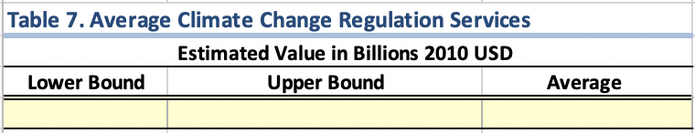
Part 2: Value of Climate Regulation Services
The last step in this section is to get an estimate for the average value of climate regulation services to include in the total estimate. In the next section you will take all these values and adjust for inflation and convert the Canadian dollars to U.S. currency to get the final estimated annual value.
1. Fill out Table 7 based on the information in Table 2 for the estimated range of the value of climate regulation benefits..
Pause for Analysis:
Some big assumptions were made in order to get these estimated values, such as assuming that households have 1.5 people. Consider the impact that such assumptions have on the final estimated value by discussing the following questions with a partner or in a small group:
Do you think it is reasonable to assume that households have 1.5 people? Why or why not? How does this assumption affect the analysis?
What are some of the other assumptions made by O’Garra that will be important to consider when assessing the final valuation?

Slide 18
Part 3: Converting Currency using Purchasing Power Parity (PPP)
Now that you have estimates for different sources of use and nonuse values in the Arctic, the last step is to convert all these values into the same currency (U.S. Dollars) for the same year (2018) by adjusting for inflation.
First, you will convert the values from the Canadian studies into USD using purchasing power parity (PPP), which measures the difference in the cost of a common bundle of goods across countries to determine the rate that currency should be converted between countries. For example, The Economist magazine is well known for its Big Mac Index, which compares the different prices of Big Macs sold around the world to the actual currency exchange rates in the market. A brief excerpt from the article says:
“The Big Mac Index is based on the theory of purchasing-power parity (PPP), which says that
exchange rates should move to make the price of a basket of goods the same in each country.
Our basket contains just a single item, a Big Mac hamburger, but one that is sold around the world.
The exchange rate that leaves a Big Mac costing the same in dollars everywhere is our fair-value
yardstick.”
For example, in 2008 dollars, a Big Mac in the United Kingdom cost £2.29 British Pounds and in the United States it cost $3.57 USD, thus the exchange rate between Pounds and Dollars based on PPP would be about $1.56 dollars to the pound. This means that the pound is more valuable than the dollar and the same item that cost £1 in the U.K. would cost $1.56 USD in the U.S. in 2008.
Source: Wikimedia Commons
Notes:
Economist article, Sandwiched: Burgernomics says currencies are very dear in Europe but very cheap in Asia from July 24th, 2008.
Website: https://www.economist.com/node/11793125

Slide 19
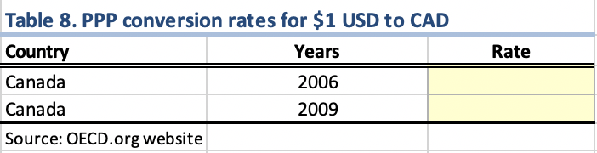
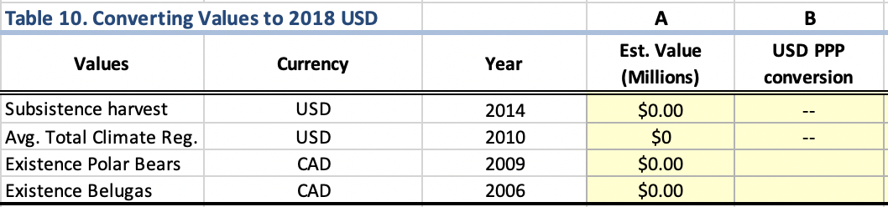
Part 3: Converting Currency using Purchasing Power Parity (PPP)
In this last section you will convert the values from the Canadian studies to USD using purchasing power parity exchange (PPP) rates from the OECD website which reports the value of $1 USD for each country listed in the table. To begin, go to the final tab in the spreadsheet for “Part 3. Final Value Calculation”.
1. To get the PPP rates go to the OECD website.
2. Find Canada on the table to determine what the value of $1 USD would be in Canadian dollars for the years 2006 and 2009.
3. Fill in the Rates for each year in Table 8.
Pause for Analysis: Suppose that the PPP of $1 in Country A is equivalent to $2 in Country B, thus the PPP rate of exchange from Country A to B is 2. If the cost of a basket of goods is $6 in Country B, what would the cost of that same basket be in Country A? Think about how this relates to the PPP rate conversion between Canada and the U.S., is Canada country A or B?
Notice in Table 10, that the values you estimated on the previous spreadsheet auto-filled into Column A.
4. Using the PPP rates recorded in Table 8, convert the CAD values in Column A to USD in Column B in Table 10. Keep in mind your answer to the Pause for Analysis question.
Notes:
OECD Website for PPP: https://data.oecd.org/conversion/purchasing-power-parities-ppp.htm

Slide 20
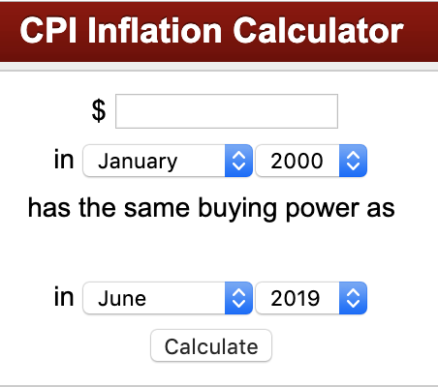
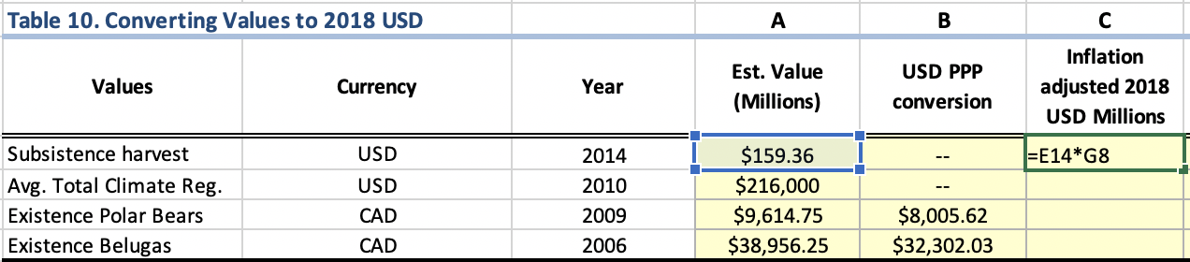
Part 3: Adjusting for Inflation
From year to year, the average price of goods and services typically increases. This increase in price over time is called inflation and is based on the Consumer Price Index (CPI), which tracks how much a typical household basket of goods costs over time. To convert all the values into 2018 USD to account for inflation, you first need to gather data on how prices have changed over time, which you will do in Table 9.
1. Go to the CPI Inflation Calculator provided by the Bureau of Labor Statistics here.
2. In the calculator, enter $1.00 and select the start year of interest (e.g. 2006). Then select January 2018 for the end year and hit “Calculate”.
3. Repeat this process and record the results in Table 9 under the “Cumulative price change” column for each year.
4. Next, fill out Column C in Table 10 using the inflation rates your just recorded to convert each value into 2018 USD as shown here.
5. Convert the values from millions to billions in Column D in Table 10, by dividing Column C by 1000.
Pause for Analysis: What is the difference between a PPP conversion and adjusting for inflation? Discuss with a partner.
Notes:
Bureau of Labor Statistics Inflation Rate Calculator: https://data.bls.gov/cgi-bin/cpicalc.pl

Slide 21
Part 3: Adjusting for Inflation
Now you can add the values you just estimated with the rest of the values in the main table by O’Garra (2017), shown in Table 11. Notice, the adjusted 2018 values you calculated in Table 10 appear in Table 11 in the grey cells. The next to last step is to convert the 2016 values from the O’Garra (2017) paper into 2018 USD. The last step is to adjust for double counting, which you will do on the next slide.
1. Fill in the yellow cells in the last column in Table 11, by converting the 2016 values from the O’Garra paper to 2018 USD by adjusting for inflation.
2. Sum the column to get the final estimated value of ecosystem services in the Arctic.
3. Notice the cell in red. You will fill in this cell on the next slide, which adjusts the final estimate to account for double counting of climate regulation benefits.
Pause for Analysis: What do you think it means to say that climate regulation benefits are being double counted in the current estimated value?
Notes:
Inflation calculator: http://www.in2013dollars.com/

Slide 22

Part 3: Adjusting for Double Counting of Benefits
The last step is to account for the benefits of climate regulation that are already incorporated into the other values of the Arctic that also depend on climate regulation. For example, the value of the existence of polar bears in part depends on the polar bears having a cold climate in which to live. Therefore we need to subtract out the value of climate regulation from these other related values, otherwise you would double count the value of climate regulation and overestimate the total value of the Arctic.
To do this you will follow O’Garra and assume that the value of climate regulation accounts for 50% of the total of related values including subsistence harvesting, polar bear hunting, and the existence values of polar bears, reindeer, and beluga whales.
1. Fill in the last two columns of Table 12 based on the assumption stated above.
2. Now you are ready to review the final estimate by summing the last column in Table 11.
Pause for Analysis: How does the final value compare to the value estimated in the O’Garra paper? Why is it different?
Notes:
Inflation calculator: http://www.in2013dollars.com/

Slide 23
Discussion Questions
With a partner or in a small group, discuss the following questions:
What do you think of the final estimated value? Is it reasonable? Why or why not?
How do you think this estimate could be used in a policy setting?
What do you think are some of the limitations of the final value estimated, i.e. what were some of the driving assumptions that influenced the final value? Do you think the assumptions are defensible?
What are other sources of value from the Arctic that are not included in the estimate here? How could you go about trying to incorporate these missing values?

Slide 24
Post-Module Assignment
Paper Addendum Assignment Overview
An addendum is an item of additional material added at the end of a book or other publication. For this assignment you will write an addendum to the O'Garra (2017) paper for the journal, Ecosystem Services, that will include a revised estimate of the TEV of the Arctic based on your research that includes an additional component in the valuation calculation. For example, you could include the existence value of penguins, or another species native to the Arctic, the value of timber harvested in the Arctic, or another missing value that you’ve identified in the current paper.
To conduct your revised calculation you must find a research article that provides an estimate of the missing value you intend to include and then you will convert the values found in that paper to the Arctic as a whole, similar to what you have done in this module.
The addendum should include the following components:
An Introduction explaining why the current estimated value in the paper is not sufficient and how you update the calculation.
A description of the added primary data source (research paper, journal article, etc.) used in your updated valuation and how the value was estimated, including any important assumptions underlying the value.
A description of the process by which you converted the data from the primary source to fit in with the estimate for the annual total economic value, including a table of your conversions and relevant sources as appropriate.
This should include a discussion of any assumptions you made in the calculation of your added value and the potential limitations and implications of these assumptions.
Results and discussion where you report the revised annual TEV of the Arctic and why this estimate is important from a policy perspective.

Slide 25
References
Boxall, P. C., Adamowicz, W. L., Olar, M., West, G. E., & Cantin, G. (2012). Analysis of the economic benefits associated with the recovery of threatened marine mammal species in the Canadian St. Lawrence Estuary. Marine Policy, 36(1), 189-197.
Economist article, Sandwiched: Burgernomics says currencies are very dear in Europe but very cheap in Asia from July 24th, 2008. Retrieved from: https://www.economist.com/node/11793125
Fall, J.A. (2016) Subsistence in Alaska: A Year 2014 Update. Division of Subsistence, Alaska Division of Fish and Game.
Goodstein, E., Euskirchen, E., & Huntington, H. (2010). An initial estimate of the cost of lost climate regulation services due to changes in the Arctic Cryosphere. Washington, DC: Pew Centre.
O’Garra, T. (2017). Economic value of ecosystem services, minerals and oil in a melting Arctic: A preliminary assessment. Ecosystem services, 24, 180-186.
Olar, M. et al. (2011). Evidence of the socio-economic importance of polar bears for Canada. Prepared by ÉcoRessources Consultants, for Environment Canada.
Purchasing Power Parities. OECD Data. Retrieved from: https://data.oecd.org/conversion/purchasing-power-parities-ppp.htm

